Slide 1
Healthcare Insight Generation from Excel

Slide 2



Project Overview: Healthcare Insights Generation from excel
This project emphasizes the importance of chronic disease management, cost optimization, and diagnostic accuracy to improve patient outcomes and operational efficiency in healthcare delivery.
Avg. Treatment Cost
$25,539
Avg. Days at Hospital
16
No of Patients
55,500

Slide 3
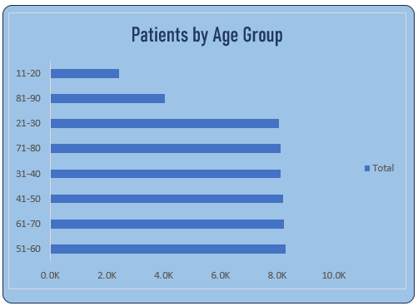
Patients by Age Group
- The highest patient concentration is between 31–70 years, especially 51–60 and 61–70 groups.
- Very few patients are in the 11–20 and 81–90 age groups, showing that middle-aged and elderly groups dominate hospital visits.

Slide 4
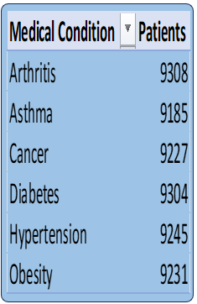
Patients By Medical Condition
Top reported conditions
Cancer (9,227 patients)
Hypertension (9,245 patients)
Diabetes (9,304 patients)
Obesity (9,231 patients)
These indicate a high prevalence
of lifestyle-related and chronic diseases,
which aligns with the long hospital stays.

Slide 5
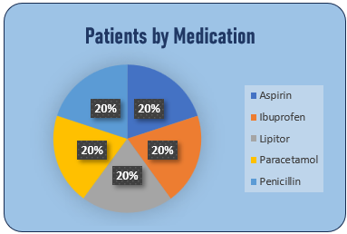
Patients by Medication
- Use of Aspirin, Ibuprofen, Lipitor, and Paracetamol are equally distributed(20% each).
-Suggests balanced prescription trends without dominance of one drug.

Slide 6
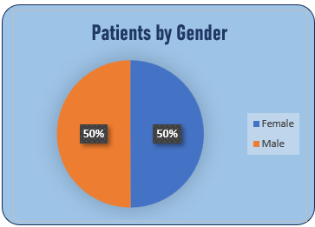
Patients by Gender
- 50% Male, 50% Female — perfect gender balance in patient distribution.

Slide 7
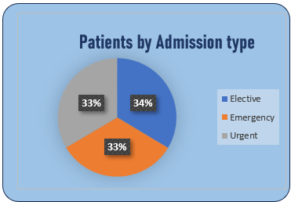
Patients by Admission Type
- Evenly distributed: Elective (34%), Emergency (33%), Urgent (33%).
- Shows a mix of planned treatments and critical admissions.

Slide 8
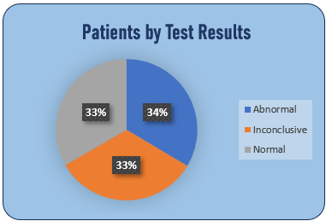
Patients by Test Results
- Nearly equal distribution: Normal (34%), Abnormal (33%), Inconclusive (33%).
- Indicates diagnostic tests provide mixed outcomes, requiring further follow-ups.

Slide 9
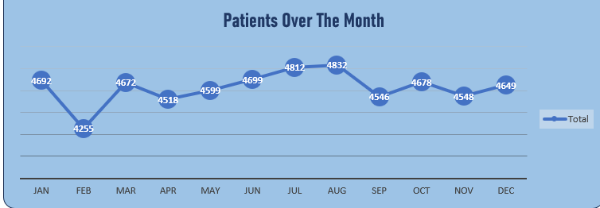
Patients Over the Months
- Patient numbers remain stable across the year (~4,500–4,800 per month) with slight peaks in March, July, and August.
- No extreme seasonal variation observed.

Slide 10
Conclusions
The hospital serves a large patient base (55k+) with high average treatment costs, reflecting either advanced treatments or costly chronic care.
The majority of patients fall in middle to old age groups (31–70 years), emphasizing the need for chronic disease management (diabetes, hypertension, cancer, obesity).
Stable patient inflow throughout the year ensures consistent hospital operations, with no heavy seasonal dependence.
Balanced gender representation shows that both men and women equally seek healthcare services.
Medication and admission types are evenly spread, suggesting well-distributed healthcare demand across categories.
- Diagnostic results show a third of patients need further evaluation (inconclusive/abnormal), highlighting the importance of continuous monitoring and follow-up care.

Slide 11
Actionable Recommendation
- Prioritize chronic disease prevention and management programs (diabetes, hypertension, obesity, cancer).
- Invest in cost optimization strategies to reduce the high average treatment costs.
- Enhance diagnostic accuracy to reduce inconclusive test results and improve patient outcomes.
- Strengthen geriatric and lifestyle-related healthcare services since most patients fall in the 31–70 age bracket.

